Slide 1
Introduction, Basic Text Processing, Edit Distance

Slide 2
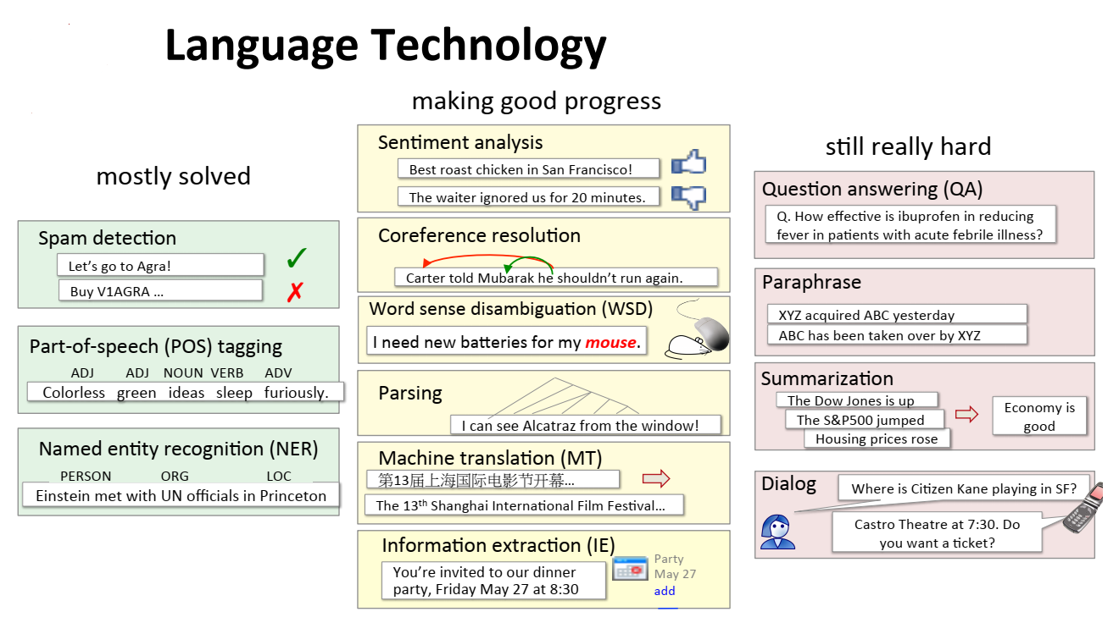
Probability recap

Slide 3
Text Processing 1. Regular expression
A formal language for specifying text strings How can we search for any of these?
Apple
apple
Apples
apples

Slide 4
Regular expression: Disjunction
Letters inside square brackets []
Patterns | Matches
[Aa]pple | Apple, apple
[1234567890] | Any digit
Ranges
Patterns | Matches
[A-Z] | Any upper case letter | I am going.
[a-z] | Any lower case letter | what are you doing
[0-9] | Any digit | Chapter 1:

Slide 5
Regular expression: Negation in Disjunction
Negations [^Ss] : carat means negation if used as 1st char inside []
Patterns | Matches
[^A-Z] | Not an upper case letter | Inot am going.
[^aA] | Not a or A | what are you doing
[^e^] | Neither e nor ^ | eleven. ^go
a^b | Pattern a carat b | Find a^b

Slide 6
Regular expression: More Disjunction
Pipe | is used for disjunction.
Patterns | Matches
apple|banana | apple, banana
1|2|3 | =[1-3]
[aA]pple|[bB]anana

Slide 7
Regular expression: * + ? .
Patterns | Matches
oo*h! | Zero or more of the previous character | oh!, ooh!, oooh!,..
oo+h! | one or more of the previous character | ooh!, oooh!,…; does not match oh!
colou?r | Zero or one of the previous character | colour, color
col.r | Any character | color, coler, colar,colwr

Slide 8
Regular expression: Anchor ^ $
^ matches the beginning of a sentence, $ matches the end of a text.
Patterns | Matches
^[A-Z] | Gpple
^[^a-zA-Z] | 1 “hi”
\.$ | end.
.$ | end. end!

Slide 9
Regular expression: examples
Find all occurrences of word ‘the’ in the text.
Patterns | Matches
the | misses capitalized examples
[tT]he | Incorrectly captures other
[^a-zA-Z][tT]he[^a-zA-Z] | correct.
Visit https://regexr.com/ to test all these regular expressions type.

Slide 10
Text Processing 2. Word Tokenization
Every NLP task needs to do text normalization: 1. Segmenting/tokenizing words in running text 2. Normalizing word formats 3. Segmenting sentences in running text

Slide 11
Words
Lemma: same stem, part of speech, rough word sense
cat and cats = same lemma
Wordform: the full inflected surface form
cat and cats = different wordforms
Type: an element of the vocabulary.
Token: an instance of that type in running text
they lay back on the San Francisco grass and looked at the stars and their 15 tokens (or 14),
13 types

Slide 12
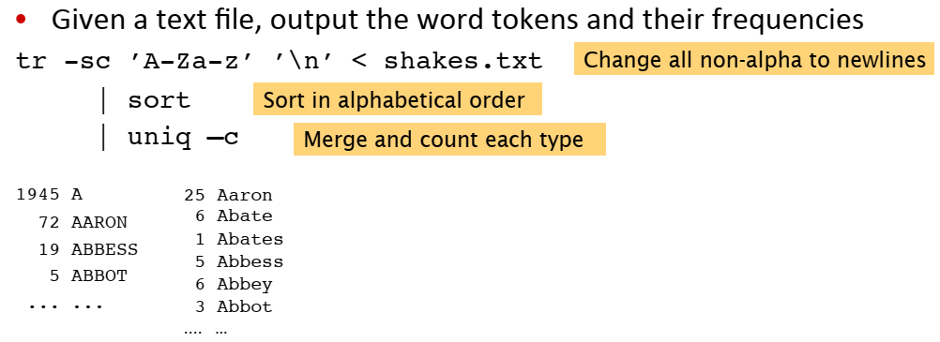
Tokenization in Linux

Slide 13
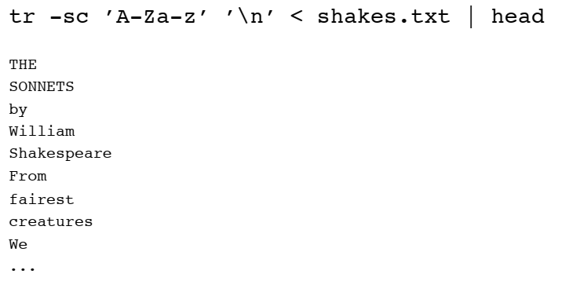
The first step: tokenizing

Slide 14
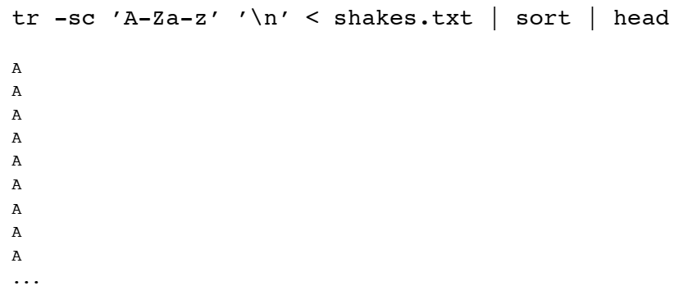
The second step: sorting

Slide 15
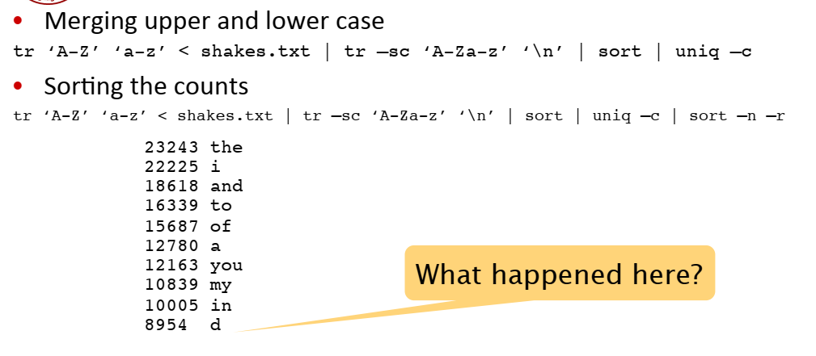
The third step: counting

Slide 16
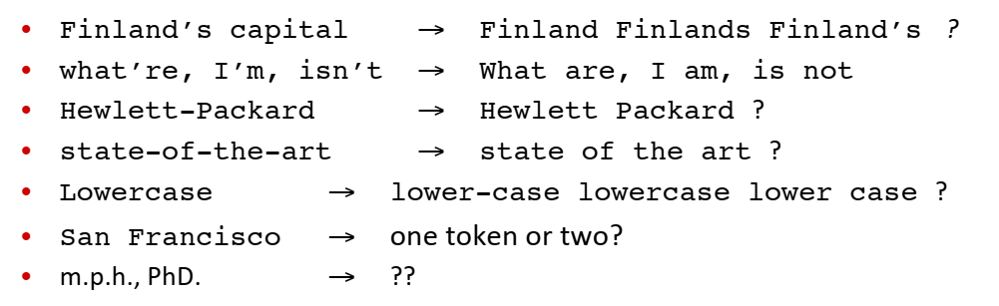
Tokenization issues
Language issues:
Chinese and Japanses words are not separated by spaces
Use maximum matching to find out tokens
Doesn’t generally work in English! - Thetabledownthere

Slide 17
Modern Tokenizers: BPE, Wordpiece
Word Tokenizers
Character Tokenizers
Sub-word Tokenizers

Slide 18
Modern Tokenizers: BPE, Wordpiece
Example from https://huggingface.co/transformers/tokenizer_summary.html

Slide 19
Modern Tokenizers: BPE, Wordpiece
Example from https://huggingface.co/transformers/tokenizer_summary.html

Slide 20
Modern Tokenizers: BPE, Wordpiece
Example from https://huggingface.co/transformers/tokenizer_summary.html

Slide 21
Modern Tokenizers: BPE, Wordpiece

Slide 22
Modern Tokenizers: BPE, Wordpiece

Slide 23
Modern Tokenizers: BPE, Wordpiece

Slide 24
Modern Tokenizers: BPE, Wordpiece

Slide 25
Modern Tokenizers: BPE, Wordpiece

Slide 26
Modern Tokenizers: BPE, Wordpiece

Slide 27
Modern Tokenizers: BPE, Wordpiece

Slide 28
Text Processing 3. Normalization & Stemming
We implicitly define equivalence classes of terms
deleting periods in a term: U.S.A and USA
asymmetric expansion : window → window, windows, Windows
Windows → Windows
Case folding: convert every letter to lowercase
Exception: uppercase in the middle of sentence – General Motors, SAIL
For MT, Sentiment analysis etc, case may be useful (US vs us)

Slide 29
Lemmatization
Reduce inflections or variant forms to base form • am, are, is → be • car, cars, car's, cars' → car
the boy's cars are different colors → the boy car be different color
have to find correct dictionary headword form

Slide 30
Morphemes
• The small meaningful units that make up words • Stems: The core meaning-­‐bearing units • Affixes: Bits and pieces that adhere to stems • Often with grammatical functions

Slide 31
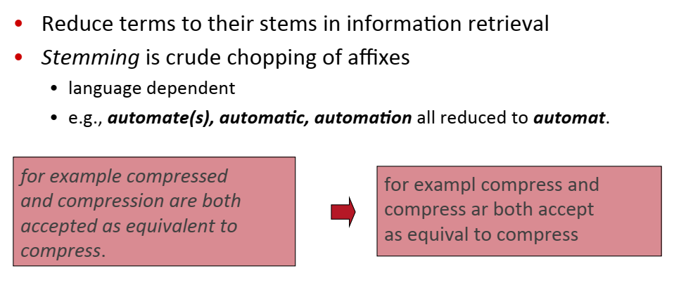
Stemming

Slide 32
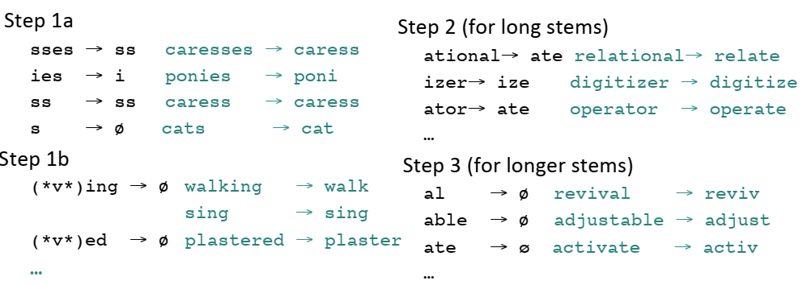
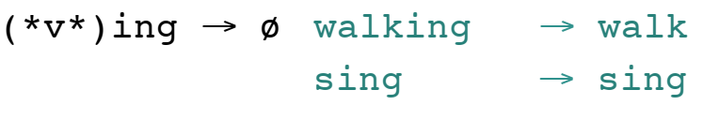
Porters Stemmer

